Slide 1
IDENTITY & ACCESS MANAGEMENT (IAM)
VIKAS

Slide 2
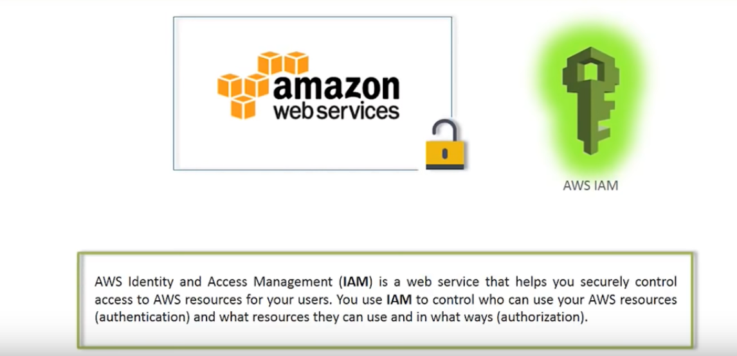
Notes:
IAM allows you to manage users and their level of access to the AWS console .
The reason for this issue is that IAM users are created with no permissions by default. That means that when you created the new IAM user, you might not provisioned any permissions to the user.
The IAM user might need to make API calls or use the AWS CLI or the Tools for Windows PowerShell. In that case, create an access key (an access key ID and a secret access key) for that user. This is called Programmatic access.
If the user needs to access AWS resources from the AWS Management Console, create a password and provide it to the user.
Uses:
1. Centralised control
2. Shared access to AWS Account
3. Granluer acces
4. Identity Federation

Slide 4
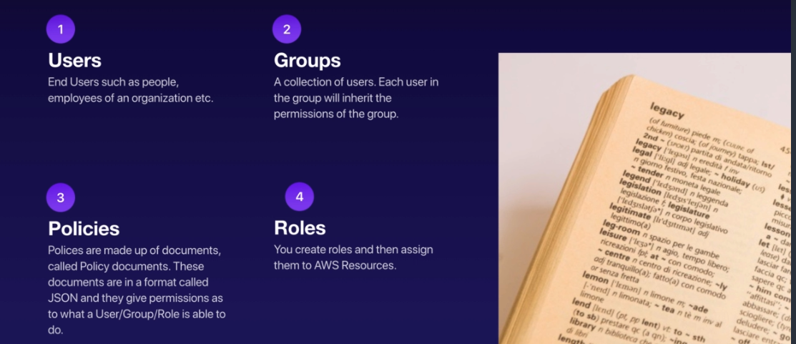
KEY TERMINOLOGIES :
Notes:
Power user : Provides full access to AWS services and resources, but does not allow management of Users and groups.
IAM => Here you a have a sign in link which can be sent to user which can be customized => activate MFA login to root account(This can be done by virtual authenticator ) => Create Individual IAM user -> mange user -> add user -> select AWS access type (Programmatic access (access key id +secret access key )+AWS Management console access ) => Set Permission => create a group => add user to the group => create user 🡺 manage password policy

Slide 5
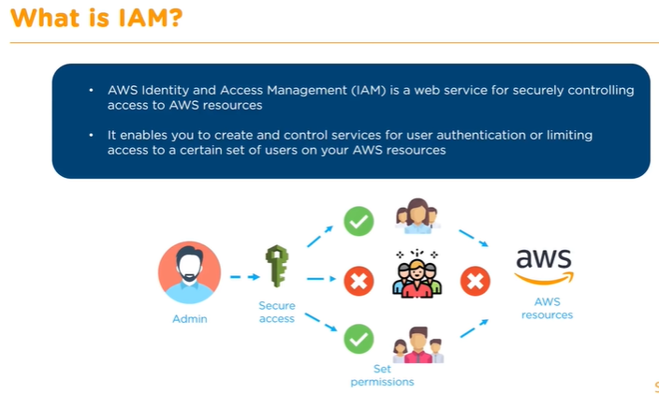

Slide 6
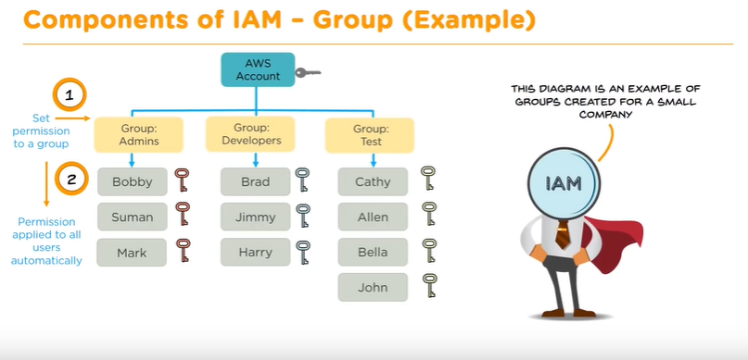

Slide 7
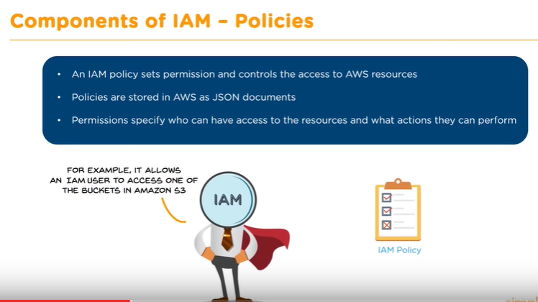

Slide 8
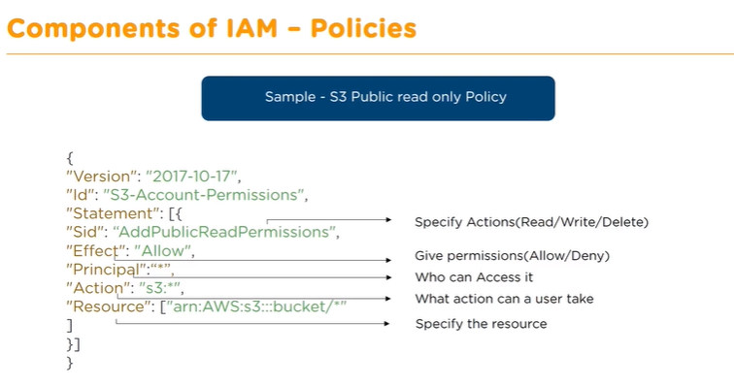

Slide 9
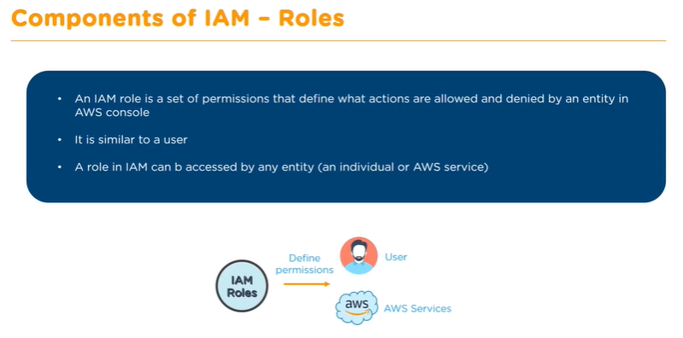
Notes:
Difference between user and role .
User permissions are hard coded whereas roles permission are accessible to any entity .Role permissions are temporary whereas user permissions are permanent .

Slide 10
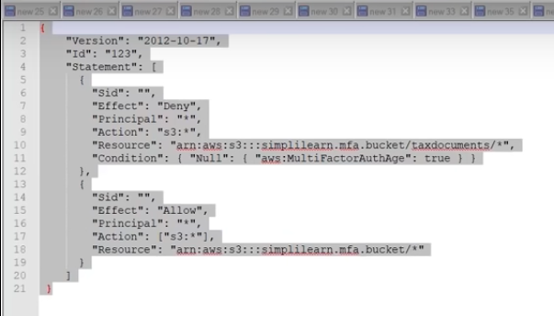
Notes:
Bucket policy to allow only users with MFA validation to enter sub folder .
Create bucket and then the si=ub folder
Create two users with s3 full access but add MFA validation for one of them .

Slide 11
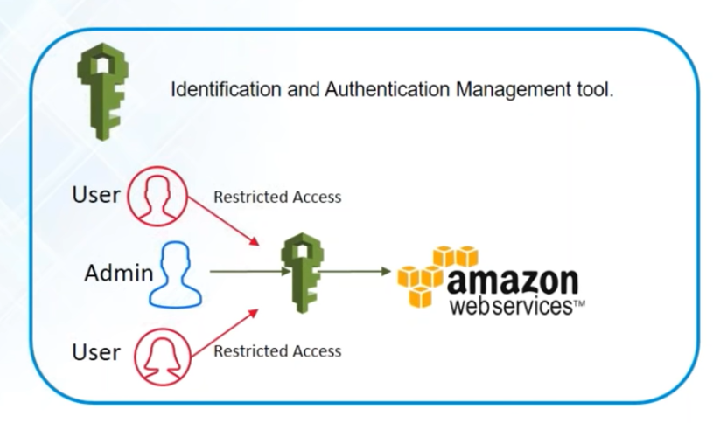

Slide 12
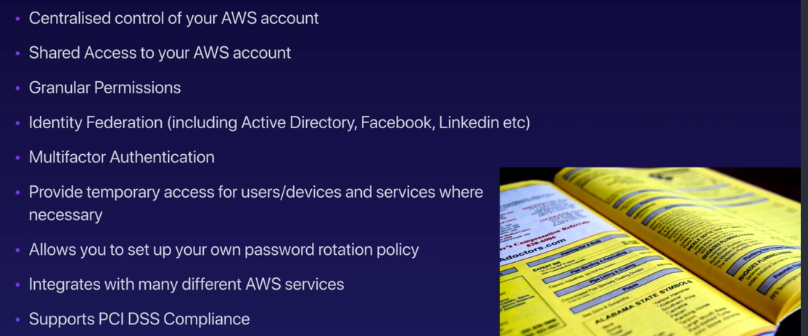
SERVICES OFFERED BY IAM :
Notes:
1 . User
2 . Group – collection of user
3 . Policies
4 . Roles
IAM console landing page will have a public DNS which can be shared and used for login .It can be customized .

Slide 13
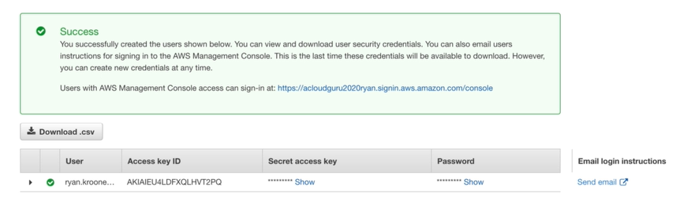

Slide 14
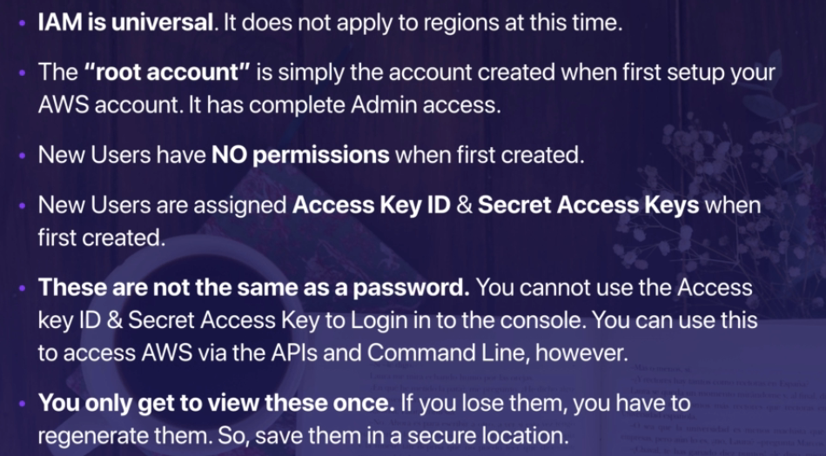
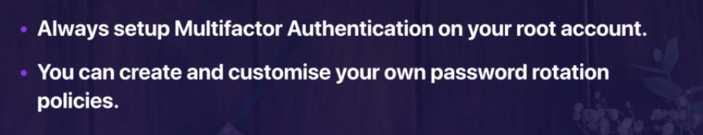
IAM IMPORTANT POINTS :
Notes:
If you provide role the you need not share login credentials .
Moreover if one login has 100 instances and by mistake any one of them get compromised you need not bother for others .

